Slide 1
Manuscript Figures!
Options, options, options
October 20, 2026
Generated with assistance from Cursor AI using out-of-date scores

Slide 2
Guiding Questions
What are the core figures and tables should go in the main manuscript?
Which would best tell the story? And what story is that?
What figures need to or should definitely be included in the supplementary?
Desired outcomes from today’s meeting:
A list of ~5 figures that I should work on for the main MS.
Flag any special data considerations associated with this list.

Slide 3
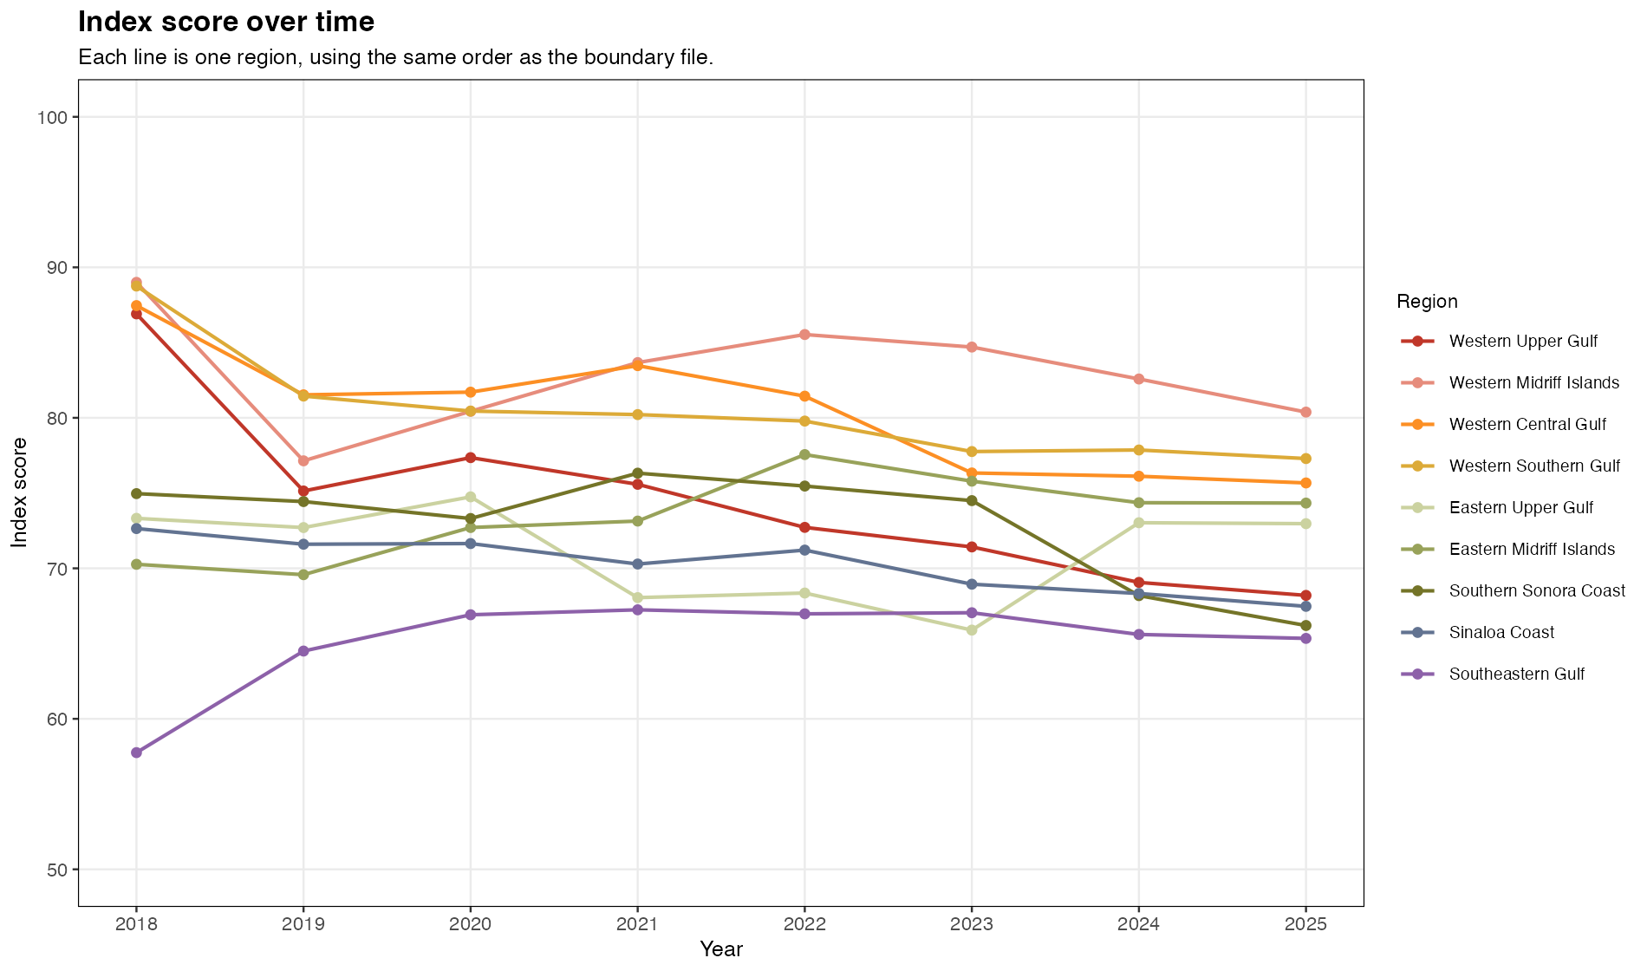
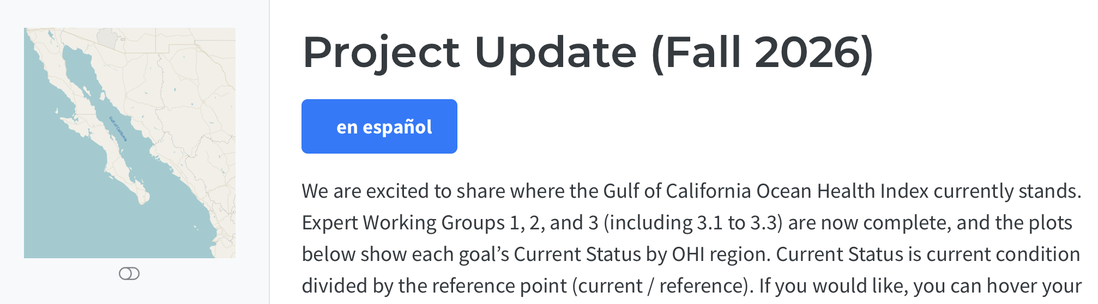
Final Score Line Plot over time, per region (2018–2025)
WE WANT THIS FIGURE! (1 of 2)
https://ohi-goc.github.io/OHI_GOC/chapters/project_update_fall_2026.html

Slide 4
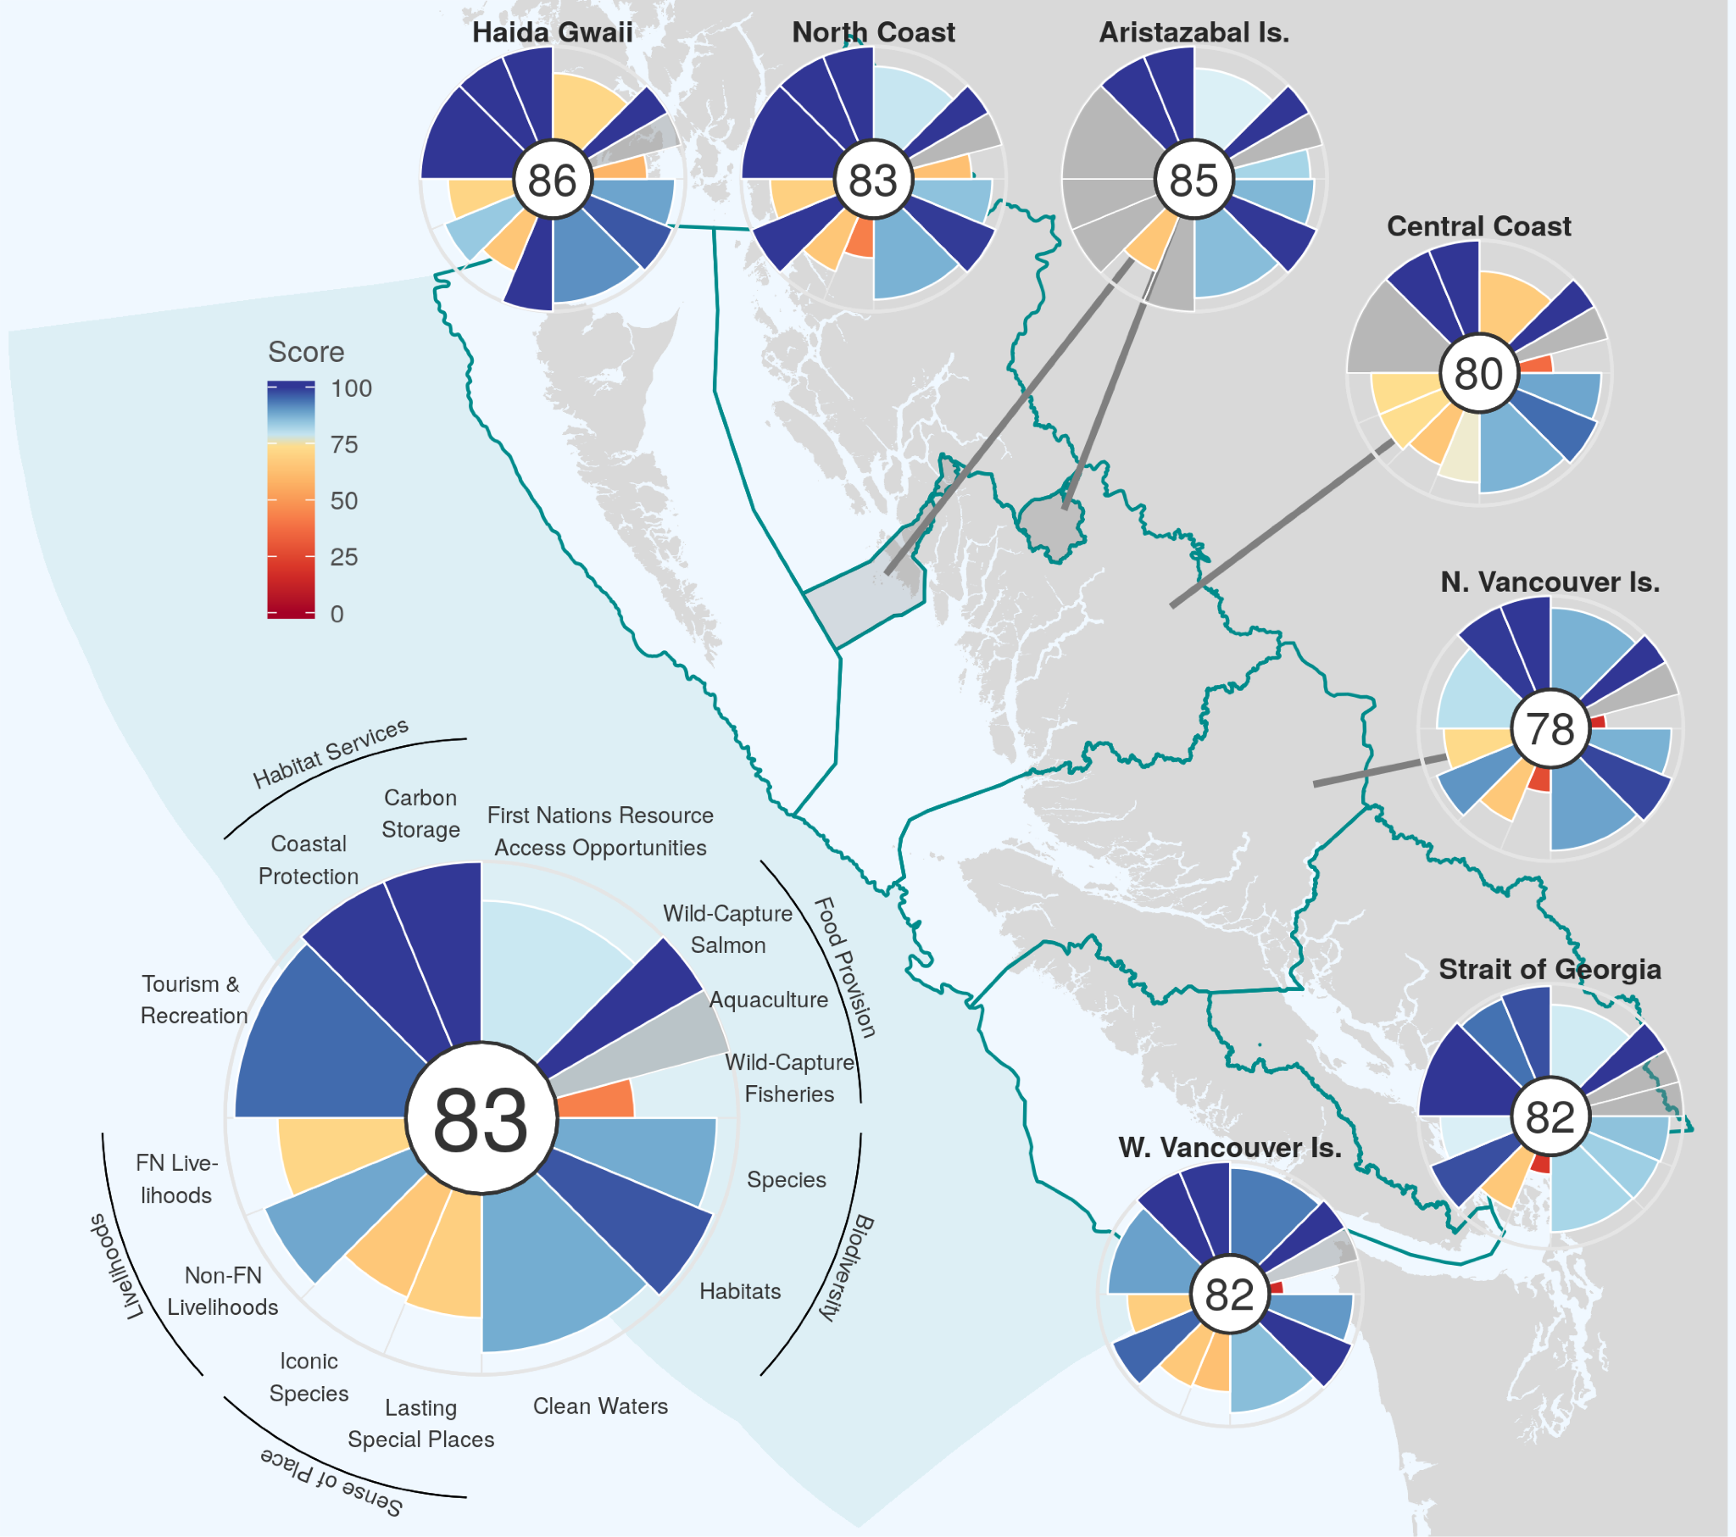
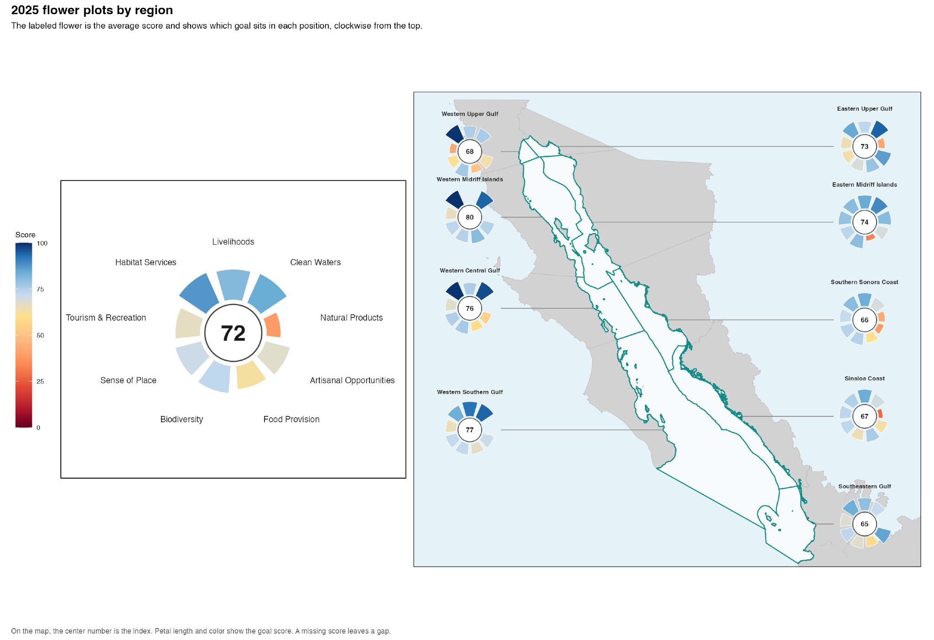
Flower Plot per region
O’Hara et al. (2020)

Slide 5
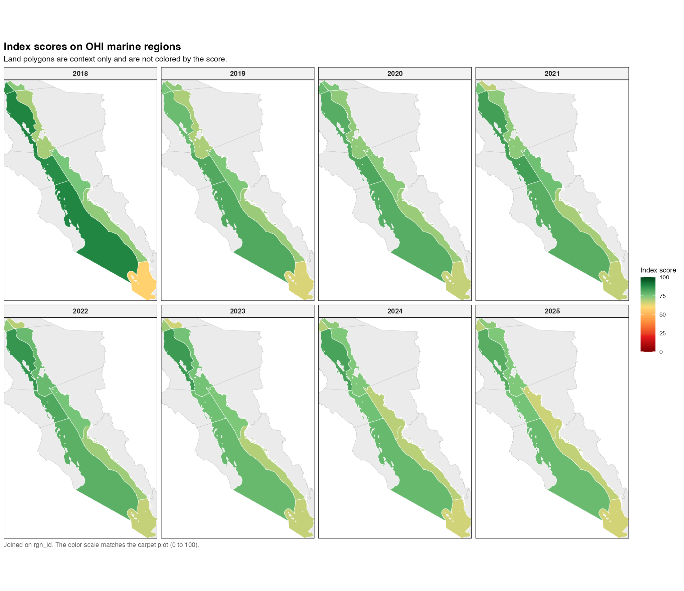
Final Score Maps Over Time (2018–2025)

Slide 6
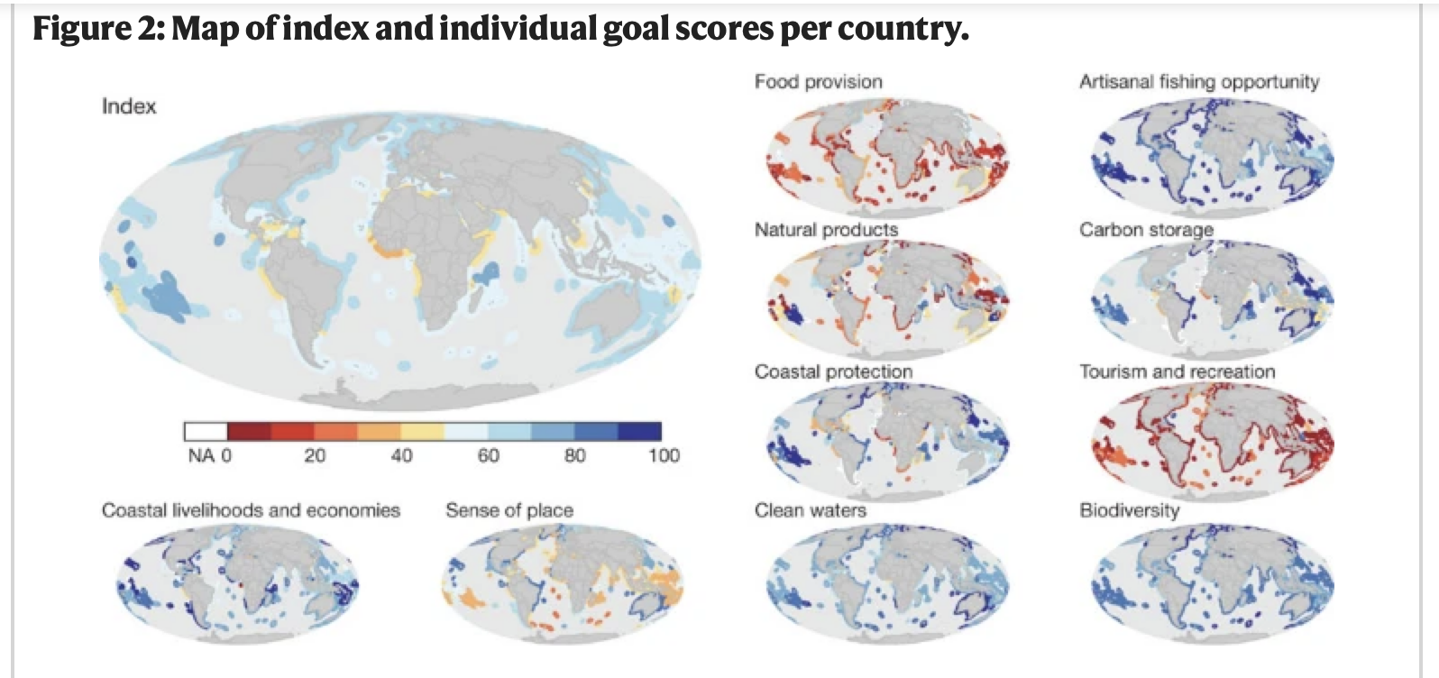
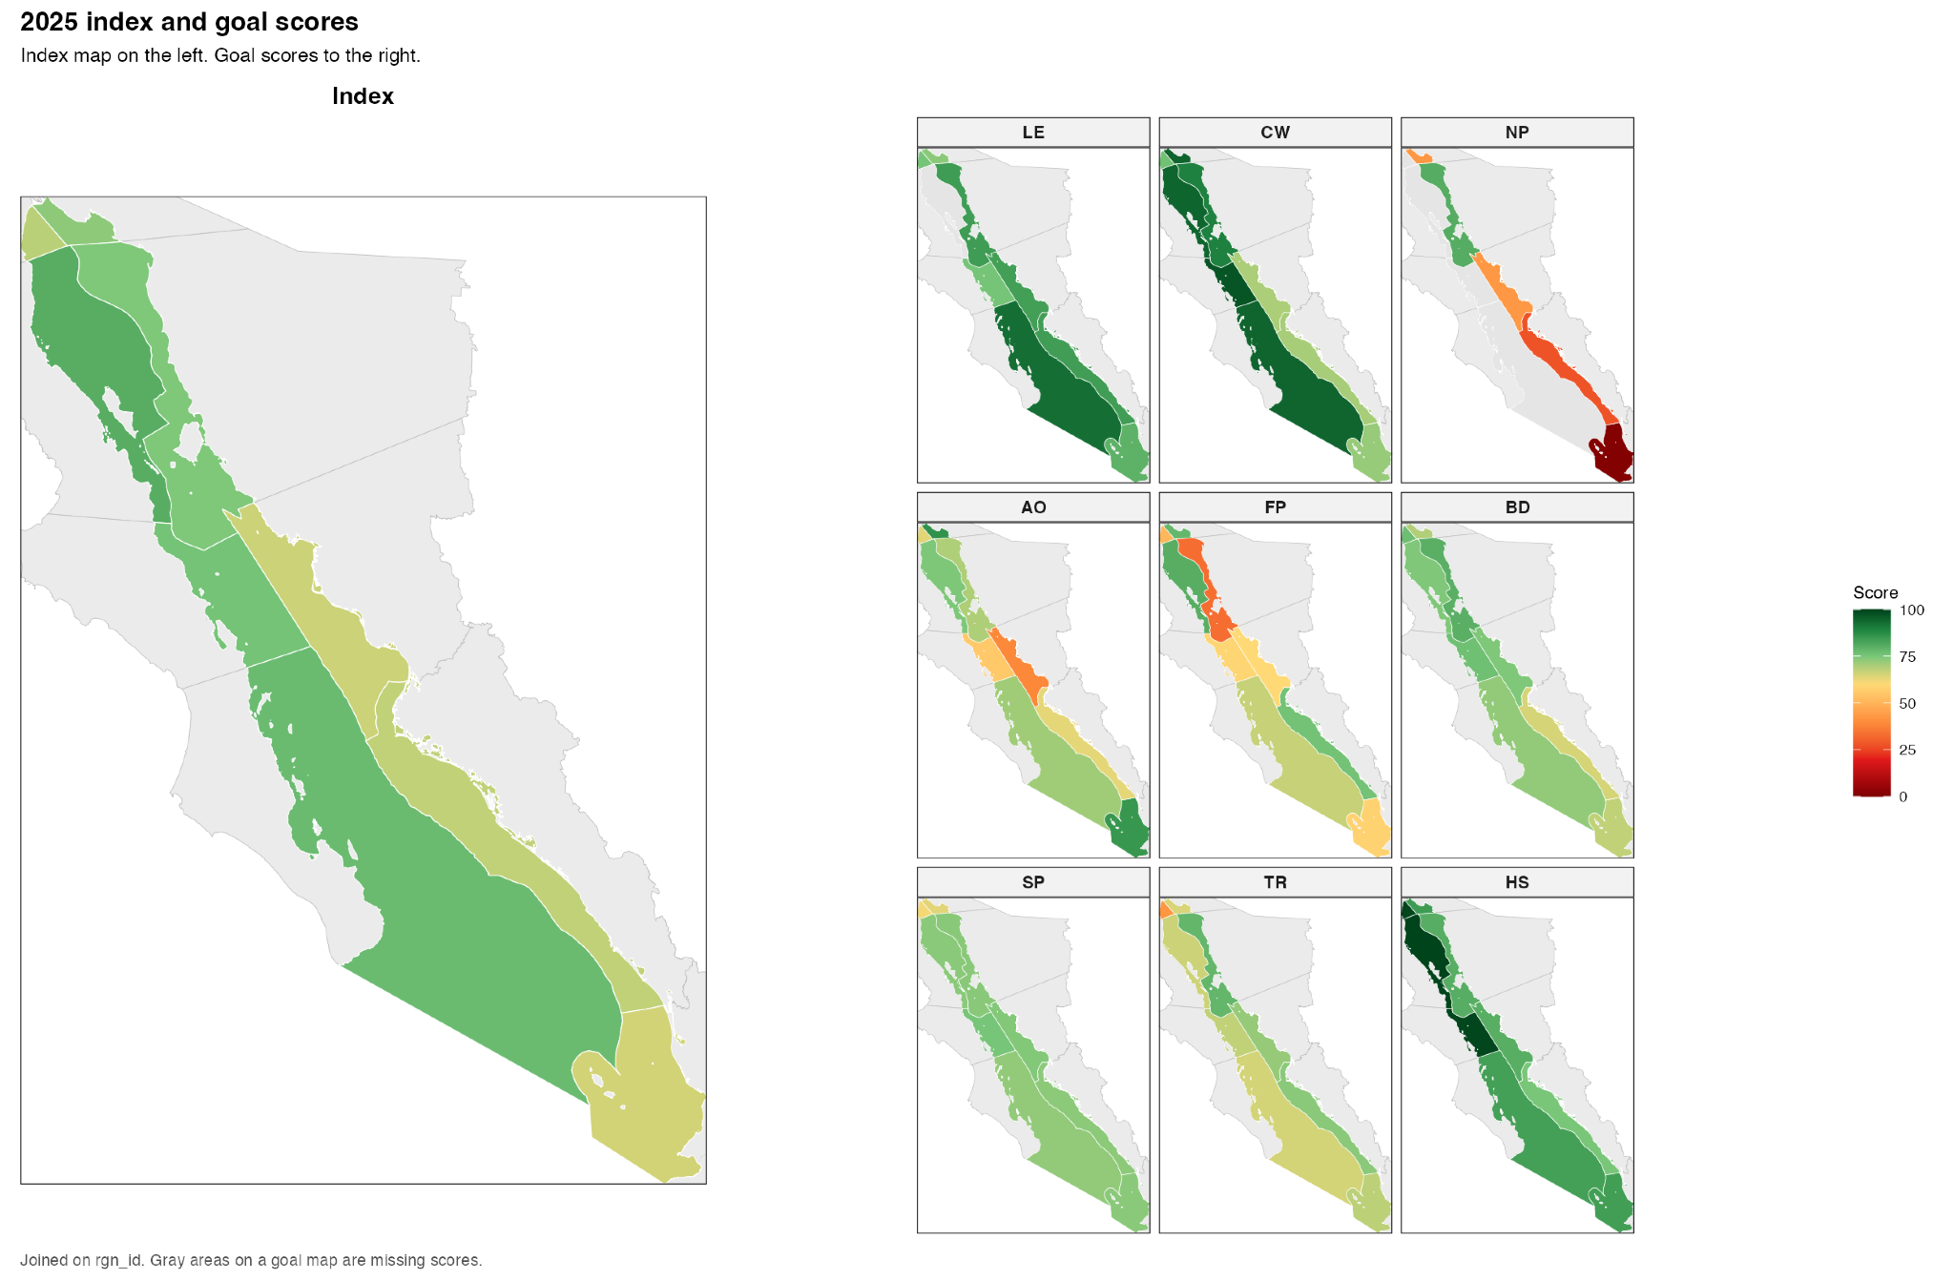
Map of Index & scores per region (2025)
WE WANT THIS FIGURE! (2 of 2)
Halpern et al. (2012)

Slide 7
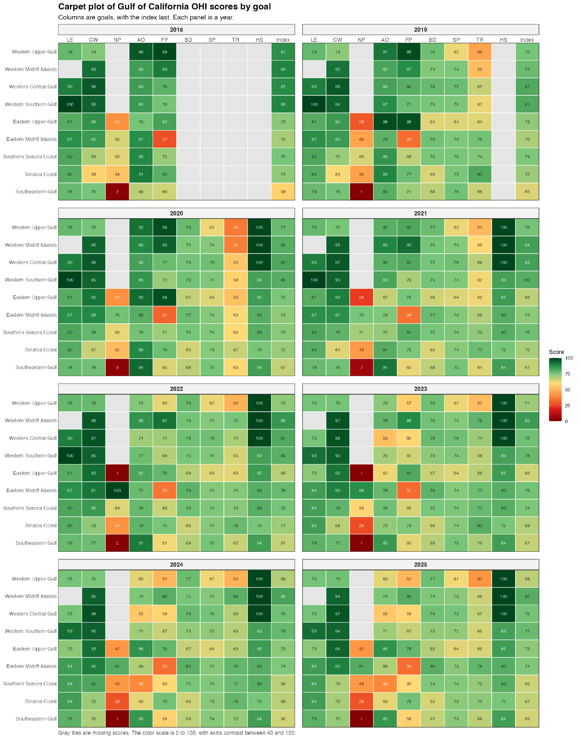
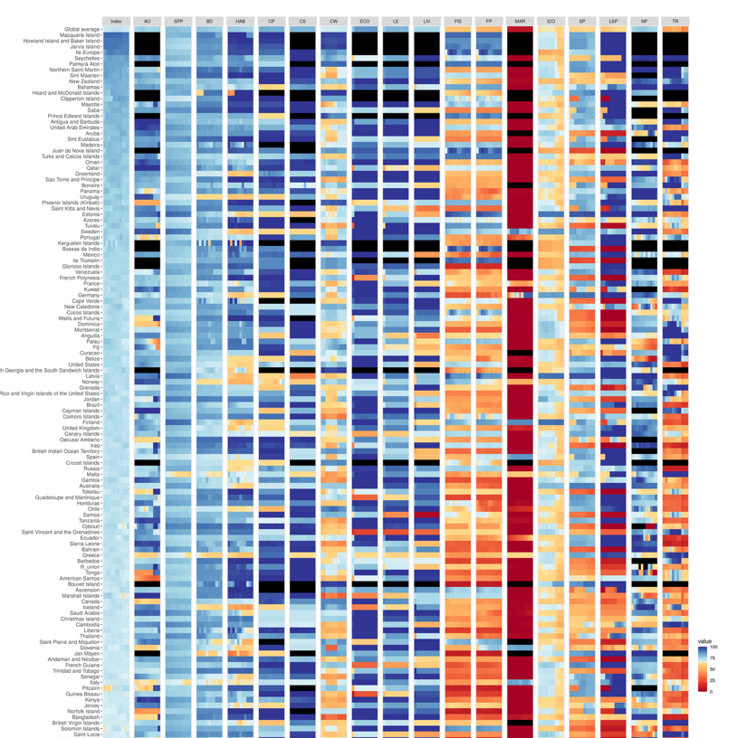
Carpet Plot of goal scores (2025 or through time…)
OHI Global (2022)

Slide 8
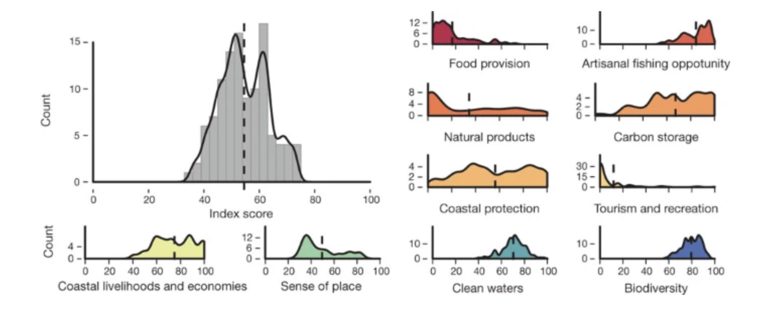
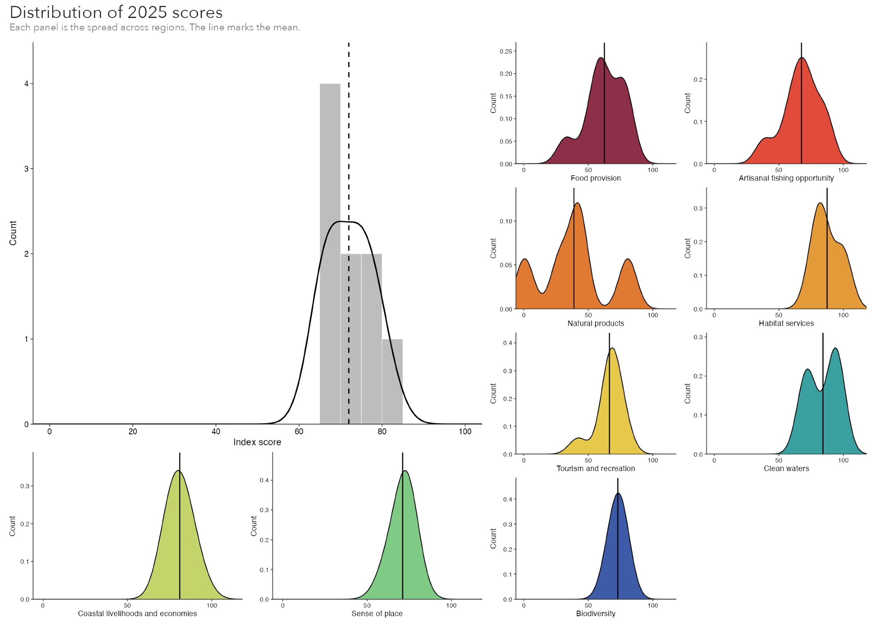
Distribution of goal scores (2025)
Halpern et al. (2012)

Slide 9
Main Table?
Region | Index Score | Pressure Score* | Resilience Score*
Alto Golfo Occidental | 68 | 50 | low
Western Midriff Islands | 80 | 30 | high
Western Central Gulf | 76 | 35 | low
Western Southern Gulf | 77 | 40 | high
Eastern Upper Gulf | 73 | 40 | medium
Eastern Midriff Islands | 74 | 30 | medium
Southern Sonora Coast | 66 | 60 | medium
Sinaloa Coast | 67 | 65 | medium
Southeastern Gulf | 65 | 50 | medium

Slide 10
Main Table?
Region | Index Score | Pressure Score* | Resilience Score*
Alto Golfo Occidental | 68 | 50 | low
Western Midriff Islands | 80 | 30 | high
Western Central Gulf | 76 | 35 | low
Western Southern Gulf | 77 | 40 | high
Eastern Upper Gulf | 73 | 40 | medium
Eastern Midriff Islands | 74 | 30 | medium
Southern Sonora Coast | 66 | 60 | medium
Sinaloa Coast | 67 | 65 | medium
Southeastern Gulf | 65 | 50 | medium

Slide 11
Main Table?
Region | Index Score | Pressure Score* | Resilience Score*
Alto Golfo Occidental | 68 | 50 | low
Western Midriff Islands | 80 | 30 | high
Western Central Gulf | 76 | 35 | low
Western Southern Gulf | 77 | 40 | high
Eastern Upper Gulf | 73 | 40 | medium
Eastern Midriff Islands | 74 | 30 | medium
Southern Sonora Coast | 66 | 60 | medium
Sinaloa Coast | 67 | 65 | medium
Southeastern Gulf | 65 | 50 | medium

Slide 12
Links if needed…
Draft of MS: https://docs.google.com/document/d/1Gg_7ZdmmKjMZXCp3gxxx3Xhx-UWnNdr2SlnNcFtxIgc/edit?tab=t.0#heading=h.x3ixpsa6w7w7
OHI info hub: https://ohi-goc.github.io/OHI_GOC/chapters/OHIregions.html
Halpern et al. (2012): https://www.nature.com/articles/nature11397
O’Hara et al. (2020): https://journals.plos.org/plosone/article?id=10.1371/journal.pone.0227502

